Slide 1
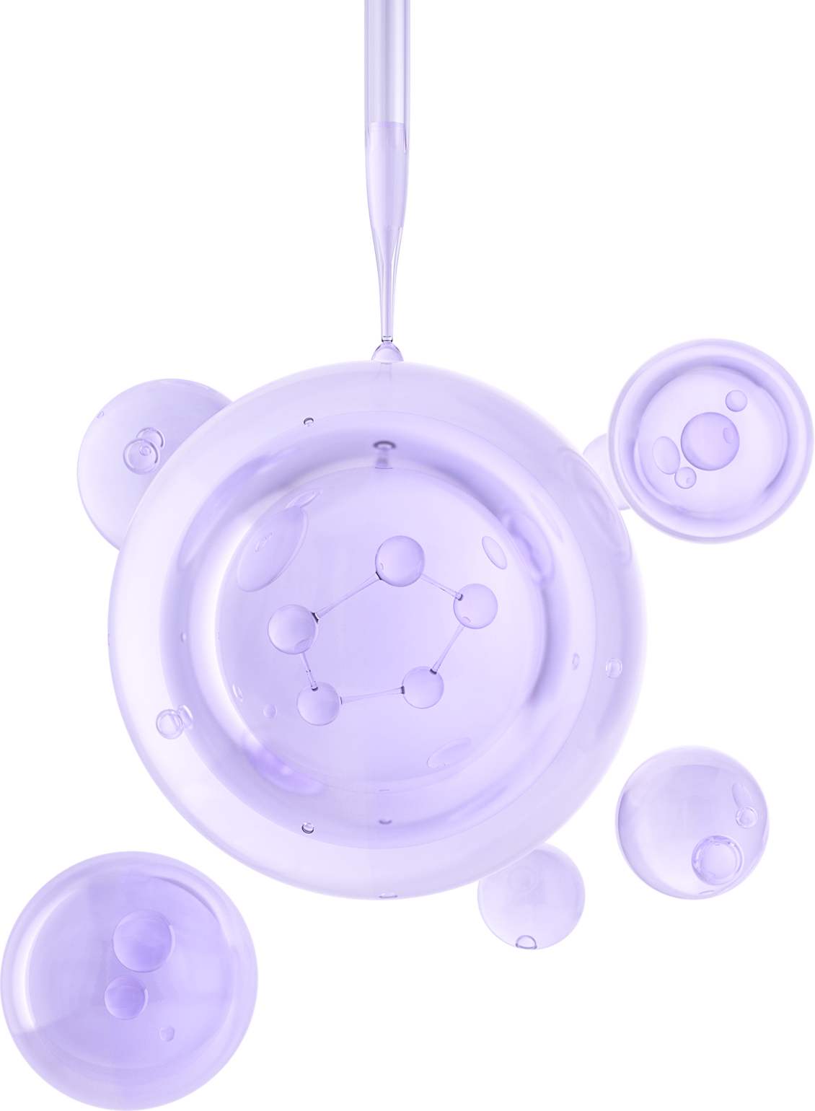
SMARTHOME
PROJECT
IOT102

Slide 2
TABLE
of contents
01. Introduction
05. Flowchart
02. Abstract
06. Simulation
03. Components
07. Demonstration
04. Block Diagram
08. Contact

Slide 3
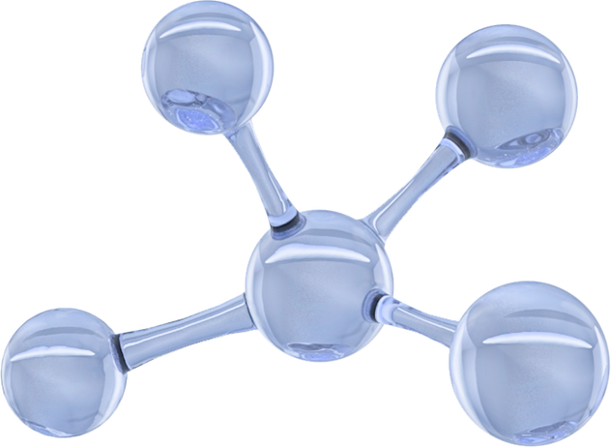

Introduction
Châu Quốc Bảo
Đàm Quang Giang
Trần Quốc Bảo
Nguyễn Khánh Tùng

Slide 4
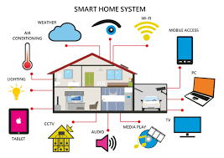
Abstract
In an increasingly modern and technologically advanced world, our IoT smart home model is a response to the ever-evolving needs and desires of individuals and families. This innovation is rooted in the pursuit of convenience, safety, and efficiency. With the integration of smart devices and sensors, we aim to simplify daily life, offering the ability to remotely control appliances and
access real-time information

Slide 5
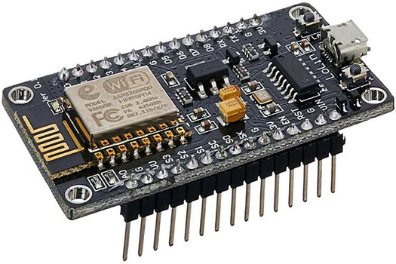
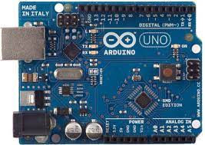
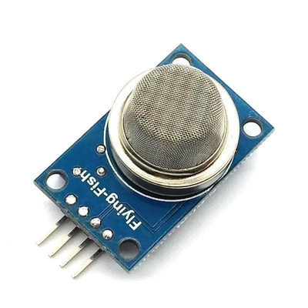
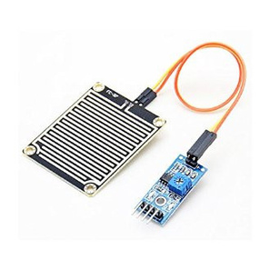
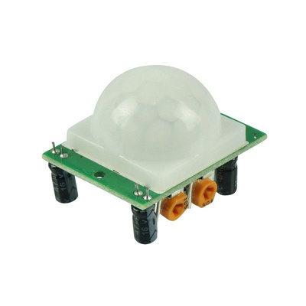
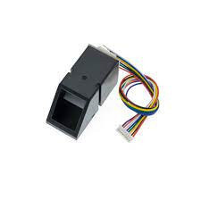
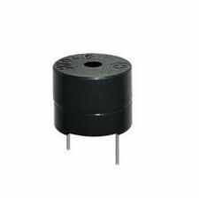
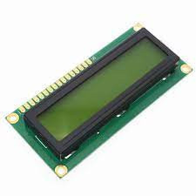
Components

Slide 6
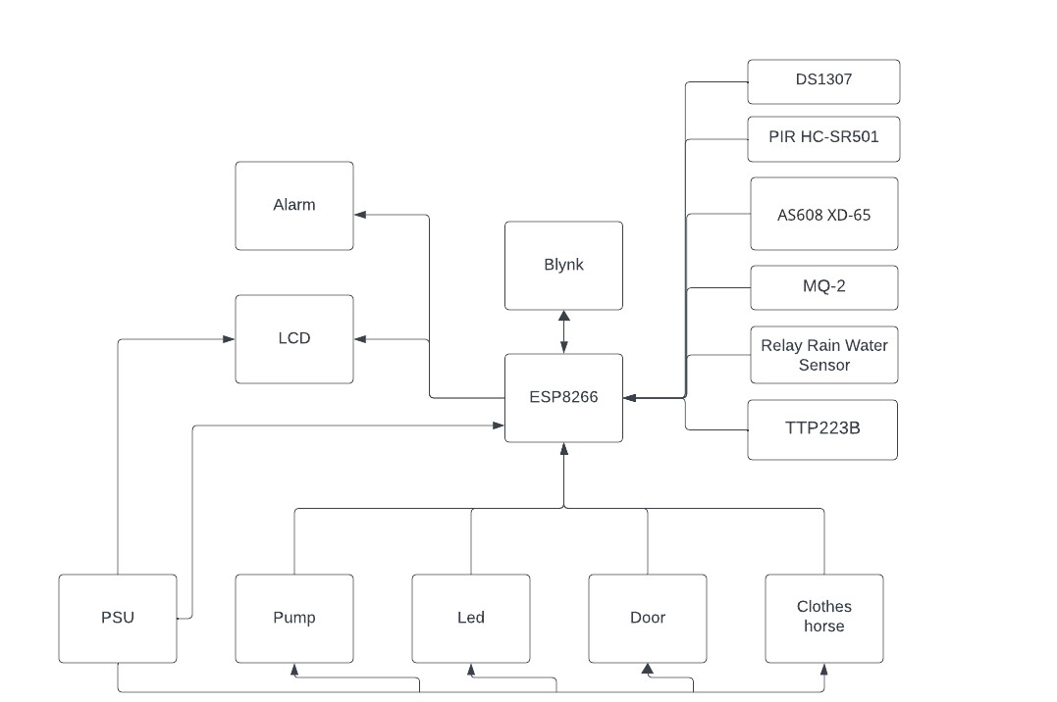
Block Diagram

Slide 7
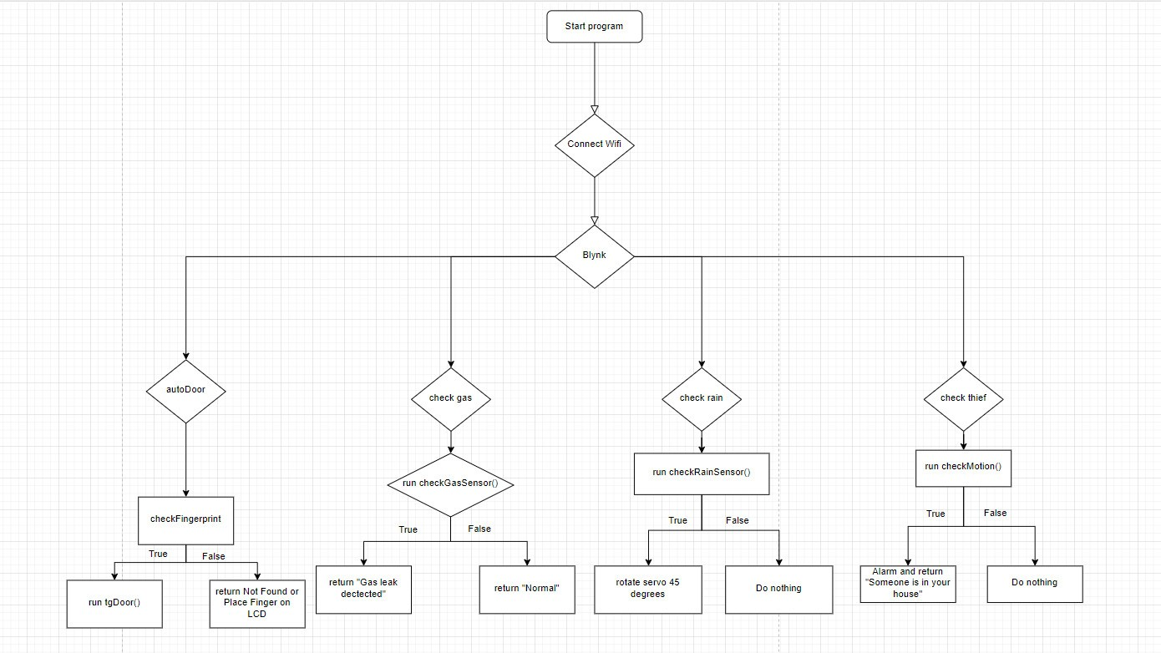
Flowchart

Slide 8
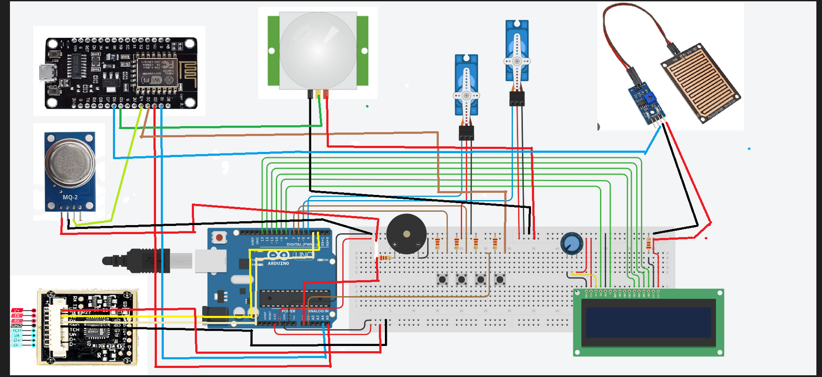
Simulation

Slide 9
Demonstration

Slide 10
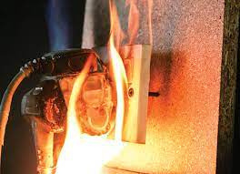


Difficulty

Slide 11
Thanks for watching

